Slide 1
Quadruped Gait Learning
Design of Control System for Quadruped using Central Pattern Generators
Shreyas Shandilya

Slide 2
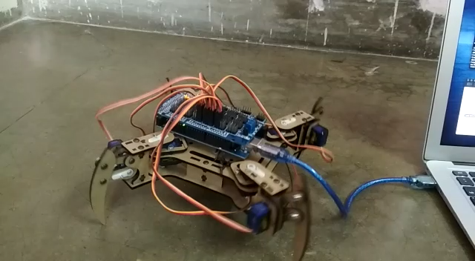
Robot walking Video
Observe the tendency of the robot to topple towards the swinging leg

Slide 3
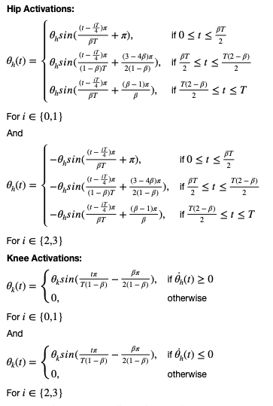
Gait Pattern
Pattern in use and problems with it
This Gait Pattern obtained from the formulation in the figure is for a creep walk of the quadruped
The robot walks with this Gait Pattern
But the stability of the quadruped is not maintained
The quadruped tends to topple towards the leg in swing phase

Slide 4
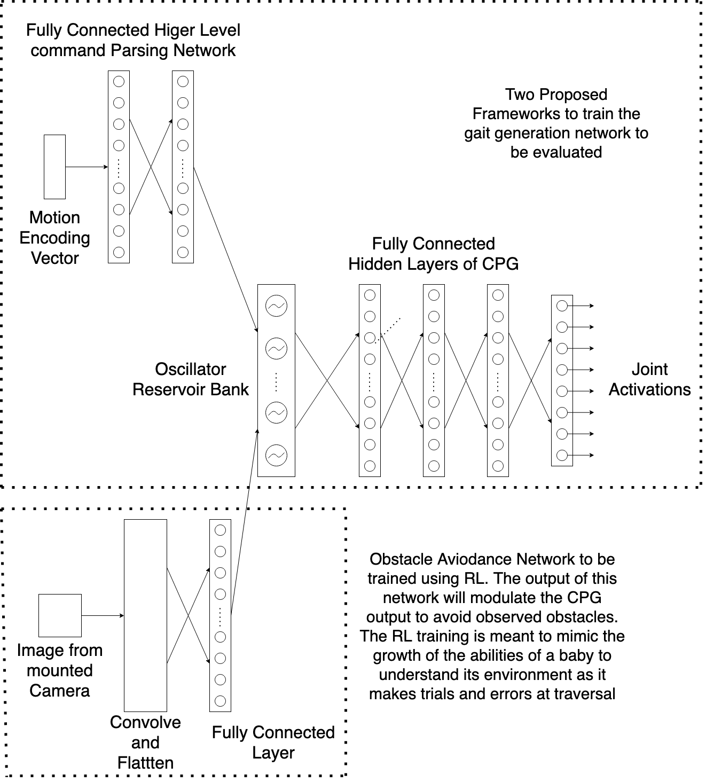
Architecture
Proposed solution to ensure gait stability
Two methods Proposed to train the gait generation network
Train the gait generation network end to end using back props and then use RL training for improvement of gait
Optimise Gait Patterns using fitness function, then train the network end to end using back prop

Slide 5
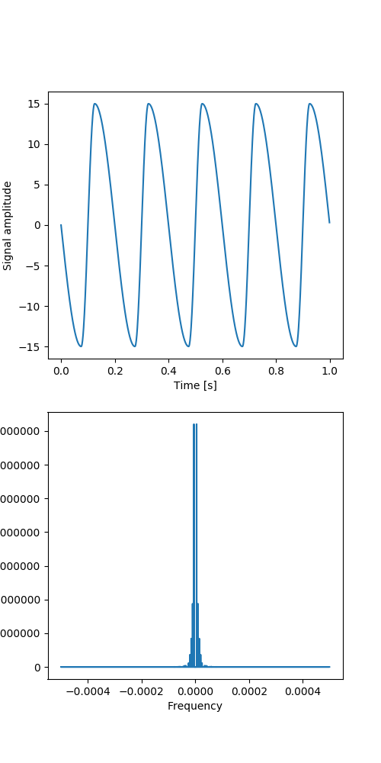
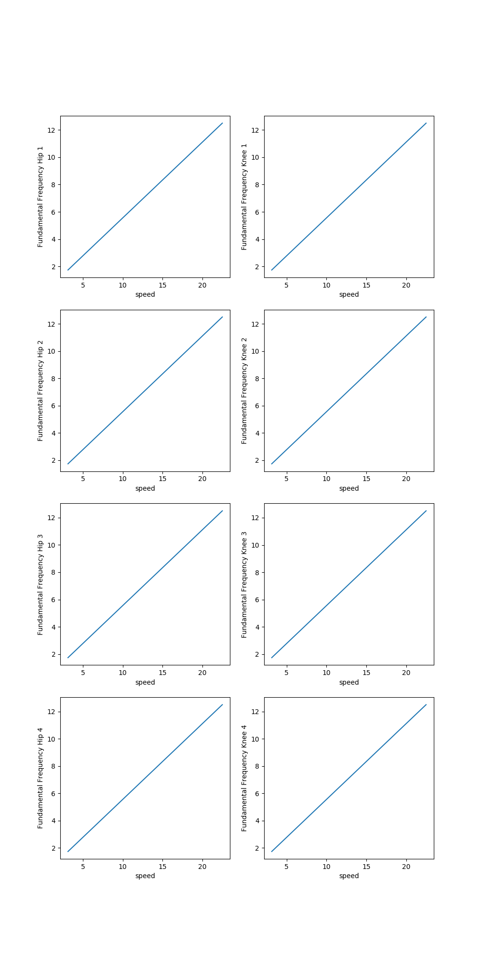
Supervised Learning of Gait Pattern
A proportional relationship between fundamental frequency of gait signal and speed of quadruped was established
Using the fundamental frequency as input, it was demonstrated that the proposed network is capable of generating gait patterns
Hip Joint Signal
Frequency spectrum of hip joint signal

Slide 6
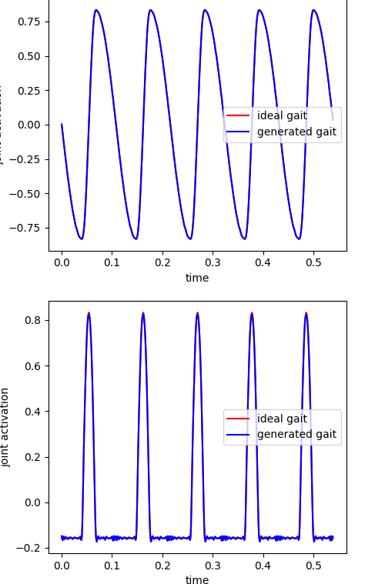
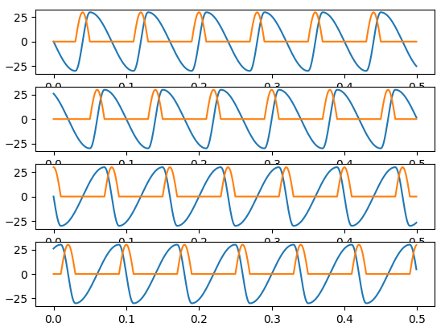
Supervised Learning of Gait Pattern
Gait Pattern for Creep Gait
Model was able to reconstruct gait signal with 100% accuracy for unto 10 different patterns at a time

Slide 7
Fitness Function
Evaluation Criteria to measure stability, speed and energy consumption
Both the aforementioned training frameworks require a Fitness Function [1]
Fitness Function must measure the following
Stability Criteria, $S$
Energy Efficiency Criteria, $E$
$F=k_{s}S_{i}+k_{e}E_{i}$ where
F is the Fitness Value
$k_{s}$ and $k_{e}$ are parameters to account for relative importance of each criteria

Slide 8
Stability Criteria
Evaluation of Dynamic and Static Stability of the Quadruped
A Quantitative Measure of quadruped’s dynamic stability
The Criteria must not only take into account current stability but must also anticipate the stability at the next time instance, given the state of motion of the quadruped, like an animal does
Yan Jia, Xiao Luo and others [2] in their paper propose a modified ZMP based stability evaluation criteria
The main idea is that at a certain state, the motion of the robot is considered to be stable if the torque caused by the ground-reaction force can prevent the robot from tumbling around any support boundary

Slide 9
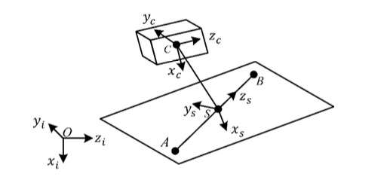
Stability Criteria
Coordinate Systems used
There are two coordinate systems of interest-
The Inertial Coordinate system
The Support Coordinate system
The Support Coordinate has z-axis along the support line AB and x axis perpendicular to the current support plane

Slide 10
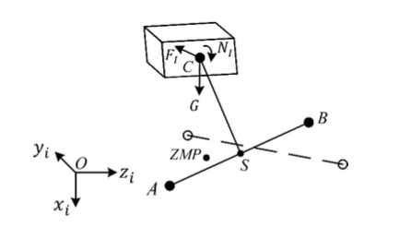
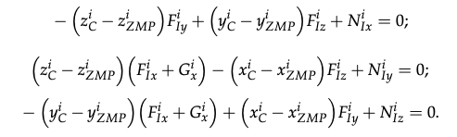
Stability Criteria
Equations for Zero Moment Point
The characteristic equations of ZMP. The inertial force and inertial moment here need to be computed by a dynamic analysis of the quadruped performed later in the report
The force schematic used to calculate the position of ZMP.
Here G is gravity, F is the inertial force on COM C, N is the inertial moment

Slide 11
Stability Criteria
Virtual Support Plane and Modified Zero Moment Point
The paper assumes that a robot is stable if the current or next set of support feet can provide the moment necessary to prevent the robot from tipping in any direction
A Virtual Support Plane is proposed and it is proposed that if the modified ZMP proposed in the paper lies within this Virtual Support Plane, then the robot motion will be stable
The Proposed Modified ZMP in the paper also includes a velocity term to account for the motion of the quadruped

Slide 12
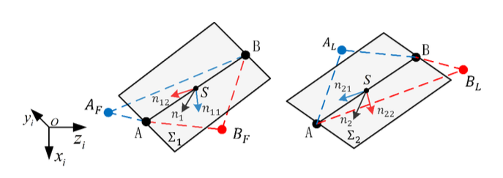
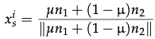
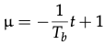
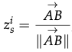
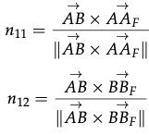
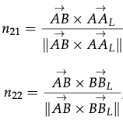
Stability Criteria
Calculating the Virtual Support Plane
S is the origin of the support coordinate system on which the ZMP will lie
$n_{1}$ is the normal vector to the plane $AA_{F}BB_{F}$
$n_{2}$ is the normal vector to the place $AA_{L}BB_{L}$
$x_{s}^{i}$, $y_{s}^{i}$ and $z_{s}^{i}$ are the normal vectors to the virtual support plane in the inertial frame of reference
$T_{b}$ is the duration between two adjacent steps and t is the time gap between the current running time and the time point when the previous support line disappeared

Slide 13
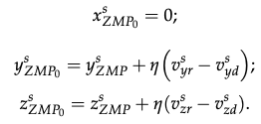
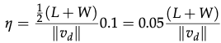
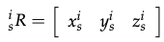
Stability Criteria
Calculation of Modified Zero Moment Point
Zero Moment Point is the point at which the resultant moment on a body is zero
Modified Zero Moment Point should-
Assess the current stability more efficiently and accurately
Provide a reference to eliminate undesired velocity during motion planning
$ZMP_{o}$ can be used to compute 3 measures of dynamic stability
Equations to calculate modified ZMP in support coordinate system. $v^{s}$ and $v^{d}$ are the actual and expected velocities in support coordinate system
L and W are the effective length and width respectively of the quadruped
Rotation Matrix for transformation from support to inertial coordinate system

Slide 14
Stability Criteria
Calculation of the metric $S$
The following three choices for $S$ can be calculated using $ZMP_{o}$-
Distances between $ZMP_{o}$ and the boundaries of the virtual-support quadrilateral in the support plane
Angle between the vector pointing from CoM to $ZMP_{o}$ and the normal vector of the virtual support place
Distance between $ZMP_{o}$ and the support line
The assumption in the paper that the legs have negligible weight compared to the rest of the body does not hold for the quadruped used
There is a need for evaluation of the repercussions on the concepts introduced

Slide 15
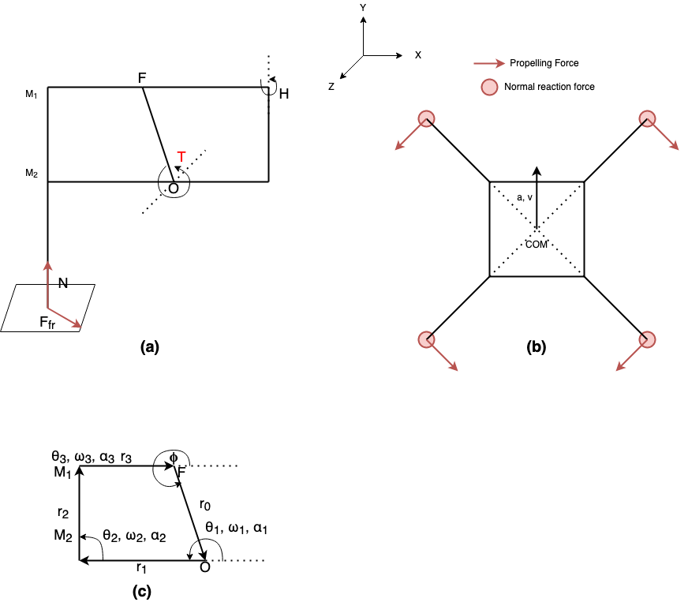
Calculating Stability Criteria
Computing ZMP for the available quadruped
The following figure depicts the simplified model of the quadruped.
$F_{fr}$ is the force due to friction acting at the point of contact. This is also the propelling force on the quadruped
$N$ is the normal reaction force from the ground
$θ$, $ω$ and $α$ are the state of the joints in the four bar linkage in (c)
Simplified model of the leg of the quadruped
Simplified model of the quadruped as seen form the top
Simplified four bar linkage to model the knee of the quadruped

Slide 16
Calculating Stability Criteria
Relationship between knee joint activation and four bar linkage model angular positions
Of the four angular positions that in the four bar linkage model of the knee joint, the angular position at $O$, $θ_{1}$ and $F$, $ϕ$ are known (being the controlled angle). Thus, the other angular positions must also be formulated in terms of $θ_{1}$ and $ϕ$. $l$, $β_{1}$, $β_{2}$ and $δ$ are intermediate variables.
$$l=\sqrt{{\overset{⃗}{|r_{0}|}}^{2}+{\overset{⃗}{|r_{1}|}}^{2}-2|r_{0}||r_{1}|cos(θ_{1}-ϕ+π)}$$
$$δ=arcsin(\frac{l}{|\overset{⃗}{r_{3}}|}sinβ_{2})$$
$$β_{1}=arcsin(\frac{|\overset{⃗}{r_{1}}|}{l}sin(θ_{1}-ϕ+π))$$
$$θ_{2}=β_{2}-β_{1}+ϕ-π$$
$$β_{2}=arccos\frac{|\overset{⃗}{r_{2}}|^{2}+l^{2}-|\overset{⃗}{r_{3}}|^{2}}{2|\overset{⃗}{r_{3}}|l}$$
$$θ_{3}=-β_{1}-δ+ϕ-π$$

Slide 17
Calculating Stability Criteria
Linkage vector in knee joint four bar linkage model
$\overset{⃗}{r_{1}}=\left[\begin{aligned}L_{1}cosθ_{1} \\ L_{1}sinθ_{1} \\ 0\end{aligned}\right]$
$\overset{⃗}{r_{2}}=\left[\begin{aligned}L_{2}cosθ_{2} \\ L_{2}sinθ_{2} \\ 0\end{aligned}\right]$
$\overset{⃗}{r_{3}}=\left[\begin{aligned}L_{3}cosθ_{3} \\ L_{3}sinθ_{3} \\ 0\end{aligned}\right]$
Here $\overset{⃗}{r_{0}}$ is fixed and $ϕ$, the angle between $\overset{⃗}{r_{0}}$ and x-axis is also fixed
$\overset{⃗}{r_{0}}=\left[\begin{aligned}L_{0}cosϕ \\ L_{0}sinϕ \\ 0\end{aligned}\right]$
$L_{0}$, $L_{1}$, $L_{2}$ and $L_{3}$ are the length of the three linkages given by $\overset{⃗}{r_{0}}$, $\overset{⃗}{r_{1}}$, $\overset{⃗}{r_{2}}$ and $\overset{⃗}{r_{3}}$ respectively.
$L_{0}$, $L_{1}$, $L_{2}$ and $L_{3}$ are the length of the three linkages given by $\overset{⃗}{r_{0}}$, $\overset{⃗}{r_{1}}$, $\overset{⃗}{r_{2}}$ and $\overset{⃗}{r_{3}}$ respectively.

Slide 18
Calculating Stability Criteria
Kinematics model of the Knee Joint
The following equations characterise the kinematic model of the knee joint.
$$\overset{⃗}{r_{1}}+\overset{⃗}{r_{2}}+\overset{⃗}{r_{3}}+\overset{⃗}{r_{0}}=\overset{⃗}{0}$$
$$r_{1x}=L_{1}cosθ_{1}$$
$$r_{1x}=L_{1}cosθ_{1}$$
$$r_{1x}=L_{1}cosθ_{1}$$
$$\overset{⃗}{v_{0}}+\overset{⃗}{v_{1}}+\overset{⃗}{v_{2}}+\overset{⃗}{v_{3}}=\overset{⃗}{0}$$
$$r_{1y}=L_{1}sinθ_{1}$$
$$r_{1y}=L_{1}sinθ_{1}$$
$$r_{1y}=L_{1}sinθ_{1}$$
$$r_{1z}=0$$
$$r_{1z}=0$$
$$r_{1z}=0$$
$$\overset{⃗}{a_{0}}+\overset{⃗}{a_{1}}+\overset{⃗}{a_{2}}+\overset{⃗}{a_{3}}=\overset{⃗}{0}$$
These relationships are shorthand for the components of the vectors $\overset{⃗}{r_{0}}$, $\overset{⃗}{r_{1}}$, $\overset{⃗}{r_{2}}$ and $\overset{⃗}{r_{3}}$
These aforementioned relationships arise as the four bar linkage is stationary with respect to $F$ and $O$.
$$r_{0x}=L_{0}cosϕ$$
$$r_{0y}=L_{0}sinϕ$$
$$r_{0z}=0$$

Slide 19
Calculating Stability Criteria
Calculating $ω$ and $α$
$$\overset{⃗}{ω_{0}}=\left[\begin{aligned}0 \\ 0 \\ 0\end{aligned}\right]$$
$$\overset{⃗}{ω_{1}}=\left[\begin{aligned}0 \\ 0 \\ ω_{1z}\end{aligned}\right]$$
$$\overset{⃗}{ω_{2}}=\left[\begin{aligned}0 \\ 0 \\ ω_{2z}\end{aligned}\right]$$
$$\overset{⃗}{ω_{3}}=\left[\begin{aligned}0 \\ 0 \\ ω_{3z}\end{aligned}\right]$$
$$\overset{⃗}{v_{O}}=0$$
The linkage $\overset{⃗}{r_{0}}$ is fixed
$$\overset{⃗}{v_{1}}=\overset{⃗}{ω_{1}}×\overset{⃗}{r_{1}}$$
Only rotation with $ω_{1}$ about origin of linkage
$$\overset{⃗}{v_{2}}=\overset{⃗}{ω_{2}}×\overset{⃗}{r_{2}}$$
Only rotation with $ω_{2}$ about origin of linkage
$$\overset{⃗}{v_{3}}=\overset{⃗}{ω_{3}}×\overset{⃗}{r_{3}}$$
Only rotation with $ω_{3}$ about origin of linkage

Slide 20
Calculating Stability Criteria
Calculating $ω$ and $α$
$$\overset{⃗}{v_{0}}=\left[\begin{aligned}0 \\ 0 \\ 0\end{aligned}\right]$$
$$\overset{⃗}{v_{1}}=\left[\begin{aligned}-ω_{1z}r_{1y} \\ ω_{1z}r_{1x} \\ 0\end{aligned}\right]$$
$$\overset{⃗}{v_{2}}=\left[\begin{aligned}-ω_{1z}r_{1y} \\ ω_{1z}r_{1x} \\ 0\end{aligned}\right]$$
$$\overset{⃗}{v_{3}}=\left[\begin{aligned}-ω_{1z}r_{1y} \\ ω_{1z}r_{1x} \\ 0\end{aligned}\right]$$
Since $\overset{⃗}{v_{0}}+\overset{⃗}{v_{1}}+\overset{⃗}{v_{2}}+\overset{⃗}{v_{3}}=\overset{⃗}{0}$, we get the following equations.
$$0-ω_{1z}r_{1y}-ω_{2z}r_{2y}-ω_{3z}r_{3y}=0$$
$$ω_{2z}=-ω_{1z}\frac{r_{1y}r_{3x}-r_{3y}r_{1x}}{r_{2y}r_{3x}-r_{3y}r_{2x}}$$
$$0+ω_{1z}r_{1x}+ω_{2z}r_{2x}+ω_{3z}r_{3x}=0$$
$$ω_{3z}=-ω_{1z}\frac{r_{2y}r_{1x}-r_{1y}r_{2x}}{r_{2y}r_{3x}-r_{3y}r_{2x}}$$
Solving the above two we get $ω_{2z}$ and $ω_{3z}$

Slide 21
Calculating Stability Criteria
Calculating $ω$ and $α$
$$\overset{⃗}{α_{0}}=\left[\begin{aligned}0 \\ 0 \\ 0\end{aligned}\right]$$
$$\overset{⃗}{α_{1}}=\left[\begin{aligned}0 \\ 0 \\ α_{1z}\end{aligned}\right]$$
$$\overset{⃗}{α_{2}}=\left[\begin{aligned}0 \\ 0 \\ α_{2z}\end{aligned}\right]$$
$$\overset{⃗}{α_{3}}=\left[\begin{aligned}0 \\ 0 \\ α_{3z}\end{aligned}\right]$$
$$\overset{⃗}{v_{O}}=0$$
The linkage $\overset{⃗}{r_{0}}$ is fixed
$$\overset{⃗}{a_{1}}=\overset{⃗}{α_{1}}×\overset{⃗}{r_{1}}+\overset{⃗}{ω_{1}}×\overset{⃗}{ω_{1}}×\overset{⃗}{r_{1}}$$
Only rotation with $α_{1}$ about origin of linkage
$$\overset{⃗}{a_{2}}=\overset{⃗}{α_{2}}×\overset{⃗}{r_{2}}+\overset{⃗}{ω_{2}}×\overset{⃗}{ω_{2}}×\overset{⃗}{r_{2}}$$
Only rotation with $α_{2}$ about origin of linkage
$$\overset{⃗}{v_{3}}=\overset{⃗}{ω_{3}}×\overset{⃗}{r_{3}}$$
Only rotation with $α_{3}$ about origin of linkage

Slide 22
Calculating Stability Criteria
Calculating $ω$ and $α$
Since $\overset{⃗}{a_{0}}+\overset{⃗}{a_{1}}+\overset{⃗}{a_{2}}+\overset{⃗}{a_{3}}=\overset{⃗}{0}$, we get the following equations.
$$0-α_{1z}r_{1y}-ω_{1z}^{2}r_{1x}-α_{2z}r_{2y}-ω_{2z}^{2}r_{2x}-α_{3z}r_{3y}-ω_{3z}^{2}r_{3x}=0$$
$$0+α_{1z}r_{1x}-ω_{1z}^{2}r_{1y}+α_{2z}r_{2x}-ω_{2z}^{2}r_{2y}+α_{3z}r_{3x}-ω_{3z}^{2}r_{3y}=0$$
Solving the above two we get $α_{2z}$ and $α_{3z}$
$$α_{2z}=\frac{r_{3x}(-α_{1z}r_{1y}-ω_{1z}^{2}r_{1x}-ω_{2z}^{2}r_{2x}-ω_{3z}^{2}r_{3x})-r_{3y}(-α_{1z}r_{1x}-ω_{1z}^{2}r_{1y}-ω_{2z}^{2}r_{2y}-ω_{3z}^{2}r_{3y})}{r_{2y}r_{3x}-r_{3y}r_{2x}}$$
$$α_{3z}=\frac{-r_{2x}(-α_{1z}r_{1y}-ω_{1z}^{2}r_{1x}-ω_{2z}^{2}r_{2x}-ω_{3z}^{2}r_{3x})+r_{2y}(-α_{1z}r_{1x}-ω_{1z}^{2}r_{1y}-ω_{2z}^{2}r_{2y}-ω_{3z}^{2}r_{3y})}{r_{2y}r_{3x}-r_{3y}r_{2x}}$$

Slide 23
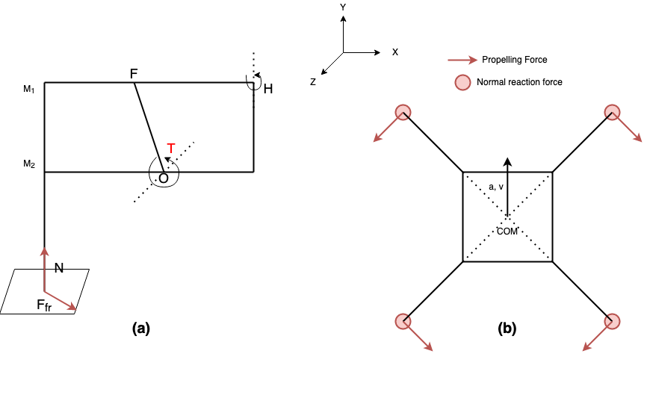
Calculating Stability Criteria
Dynamic Model of the Available Quadruped
$$∑\overset{⃗}{F_{fr}}+∑\overset{⃗}{N}-m\overset{⃗}{g}=m\overset{⃗}{a}$$
$$\underset{i}{∑}\overset{⃗}{F_{fr}}×R_{i}+\underset{i}{∑}\overset{⃗}{N}×R_{i}=I_{R}\overset{⃗}{α_{R}}$$
The above two equations depict the dynamics of the quadruped in vector form. Rotation is possible about the $y$ and $z$ axes, while translation is only possible along the $y$ and $z$ axes.

Slide 24
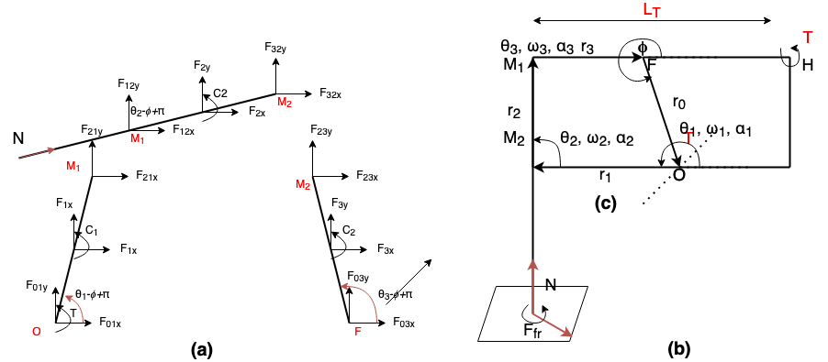
Calculating Stability Criteria
Stance Dynamics
Illustration of all forces acting on the four bar linkage in the knee during stance phase. The segment M1H will be rigid during stance
A simplified model of a leg. $N$ and $F_{fr}$ are normal reaction and friction forces respectively

Slide 25
Calculating Stability Criteria
Stance Dynamics
$$F_{01x}+F_{1x}+F_{21x}=0$$
$$F_{01y}+F_{1y}+F_{21y}=0$$
$$\overset{⃗}{F_{23}}=-\overset{⃗}{F_{32}}$$
$$F_{01y}+F_{1y}+F_{21y}=0$$
$$C_{1}=0$$
$$\overset{⃗}{F_{21}}=-\overset{⃗}{F_{12}}$$
$$F_{12x}+F_{2x}+F_{32x}+Ncosθ_{2}-ϕ+π=0$$
$$C_{2}=0$$
$$F_{12y}+F_{2y}+F_{32y}+Nsinθ_{2}-ϕ+π=0$$
$$C_{3}=0$$
$$F_{01x}+F_{1x}+F_{21x}=0$$
$$T+C_{1}-F_{1x}\frac{|\overset{⃗}{r_{1}}|}{2}cosθ_{1}-ϕ+π+F_{1y}\frac{|\overset{⃗}{r_{1}}|}{2}cosθ_{1}-ϕ+π+F_{21y}|\overset{⃗}{r_{1}}|cosθ_{1}-ϕ+π-F_{21x}|\overset{⃗}{r_{1}}|sinθ_{1}-ϕ+π=0$$
$$C_{2}-F_{2x}\frac{|\overset{⃗}{r_{2}}|}{2}cosθ_{2}-ϕ+π+F_{2y}\frac{|\overset{⃗}{r_{2}}|}{2}cosθ_{2}-ϕ+π+F_{32y}|\overset{⃗}{r_{2}}|cosθ_{2}-ϕ+π-F_{32x}|\overset{⃗}{r_{2}}|sinθ_{2}-ϕ+π=0$$
$$C_{3}-F_{3x}\frac{|\overset{⃗}{r_{3}}|}{2}cosθ_{3}-ϕ+π+F_{3y}\frac{|\overset{⃗}{r_{3}}|}{2}cosθ_{3}-ϕ+π-F_{23y}|\overset{⃗}{r_{1}}|cosθ_{1}-ϕ+π+F_{23x}|\overset{⃗}{r_{1}}|sinθ_{1}-ϕ+π=0$$

Slide 26
Calculating Stability Criteria
$$\overset{k}{\underset{i}{∑}}N_{i}-mg=0$$
Calculating $\overset{⃗}{F_{fr}}$ and $\overset{⃗}{N}$
$\overset{⃗}{F_{fr}}$ and $\overset{⃗}{N}$ are the friction and normal reaction acting at the points of contact with the ground
To compute these forces the dynamics at the point of contact need to be considered
For a successful walking motion, there must be no slipping at the point of contact
Thus, we need to solve for equilibrium conditions there
where k is the number of legs in contact with the group
$$T-F_{fr}L_{T}=0$$
This is the condition of no slipping at the point of contact with the ground
$$∑\overset{⃗}{F_{fr}}=m\overset{⃗}{a}$$
The sum of all frictional forces are responsible for the horizontal acceleration $a$ of the quadruped

Slide 27
Calculating Stability Criteria
Calculating Inertial Force and Moment at COM
The Inertial Force at the COM is given by $m\overset{⃗}{a}$, where $\overset{⃗}{a}$ is the acceleration of the COM
The Moment at COM is given by $I_{R}\overset{⃗}{α_{R}}$, which is calculated by solving the dynamics of the quadruped
Once the Inertial Force and Moment at the COM are known, the modified ZMP can computed using the method proposed in [2], which can then be used to compute the stability criteria

Slide 28
Solving Quadruped Dynamics
Solving a system of linear equations
The dynamics equations of the quadruped together form a system of 69 equations and 69 variables
$AX=B$ is a system of linear equations with $X$ being the vector of the unknowns, $A$ the matrix of coefficients and $B$ the constants
$X=A^{-1}B$ gives the solution to the aforementioned system of linear equations

Slide 29
Solving Quadruped Dynamics
Solving a system of linear equations
Some simplifying assumptions were made to formulate the system of linear equations
A binary factor $γ_{i}$ was introduced for each leg. If $γ_{i}=0$ there is no contact with the ground at the leg, else there is contact
If $γ_{i}=γ_{j}=0$, then $N_{i}=N_{j}=0$.
If $γ_{i}=γ_{j}=1$, then $N_{i}=N_{j}≠0$
The resistive force at the hip joint is given by $ϵ_{i}$ when leg $i$ is not in contact with the ground
Movement is on a flat surface with coefficient of friction $μ$
At least two legs are in contact with the ground at all points of time

Slide 30
Energy Efficiency Criteria
Calculation of metric $E$
$$P_{avg}=\frac{1}{T}\overset{4}{\underset{i=1}{∑}}\overset{2}{\underset{j=1}{∑}}∫_{0}^{T}|τ_{i,j}{\overset{·}{θ}}_{i,j}(t)|dt$$
Energy Criteria E measures the energy efficiency of the quadruped
The Criteria is inspired by the objective function used in [9]
There are three aspects of the Energy Efficiency Criteria
Mean Power $P_{avg}$
Mean Power Derivation $D_{avg}$
Mean Torque Consumption $P_{L}$
$$E=P_{avg}+D_{avg}+P_{L}$$
$$D_{avg}=\sqrt{\frac{1}{T}∫_{0}^{T}(\overset{4}{\underset{i=1}{∑}}\overset{2}{\underset{1}{∑}}τ_{i,j}{\overset{·}{θ}}_{i,j}(t)-P_{avg})^{2}dt}$$
$$P_{L}=\frac{1}{T}\overset{4}{\underset{i=1}{∑}}\overset{2}{\underset{j=1}{∑}}∫_{0}^{T}(τ_{i,j}(t))^{2}dt$$

Slide 31
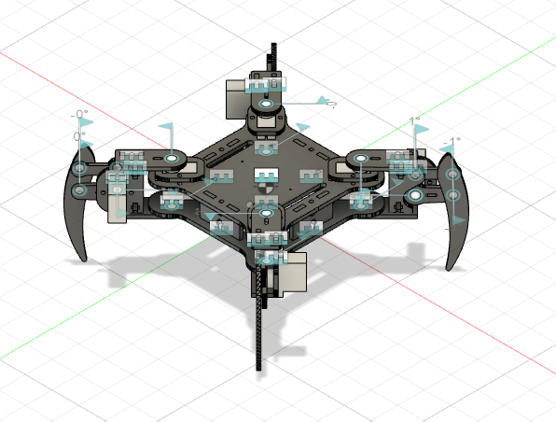
3D model
Quadruped Assembly on Fusion 360
Need for 3D model-
Precise mass of quadruped components
Precise Position of leg COM
Moment of Inertia in Knee four bar linkage
Easier method for URDF model generation
Calculating Joint motion ranges
Fusion 360 can also be used for ML

Slide 32
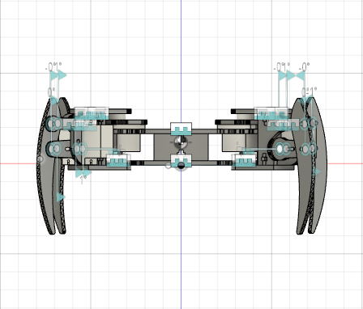
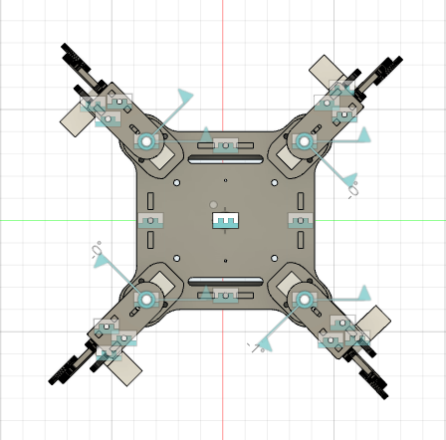
3D model
Quadruped Assembly on Fusion 360

Slide 33
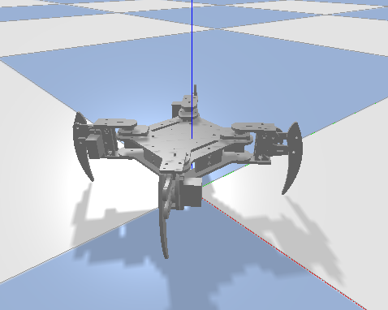
PyBullet
Collision and Inertia Model of the quadruped
Collisions in the quadruped to be modelled using simple shapes like cylinder, boxed and spheres
There is a need for a simpler model as the collision model using meshes requires compute power not currently available

Slide 34
ROS and Gazebo
Due to the limitations of the PyBullet API, the environment for RL had to be changed from PyBullet to ROS and Gazebo
ROS implementation has a much lower simulation to hardware transfer time and Gazebo provides the flexibility of adding sensors into the simulations as needed
Pybullet lacks a forward kinematics module that is needed for computing the future contact positions for the Stability Criteria
MoveIt! Plugin with Gazebo can be very easily be used to get forward as well as inverse kinematics of the quadruped
Gazebo also simplifies Stability Criteria Calculation as it directly provides callbacks for dynamics and kinematics from the physics engine used

Slide 35
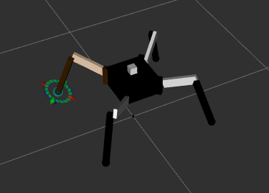
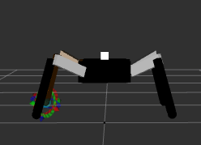
ROS and Gazebo
Simplified Quadruped Model
The initially developed quadruped URDF model required very high computational power for proper simulation, which is not available
A simplified URDF model was developed to simulate the kinematics and dynamics of the quadruped

Slide 36
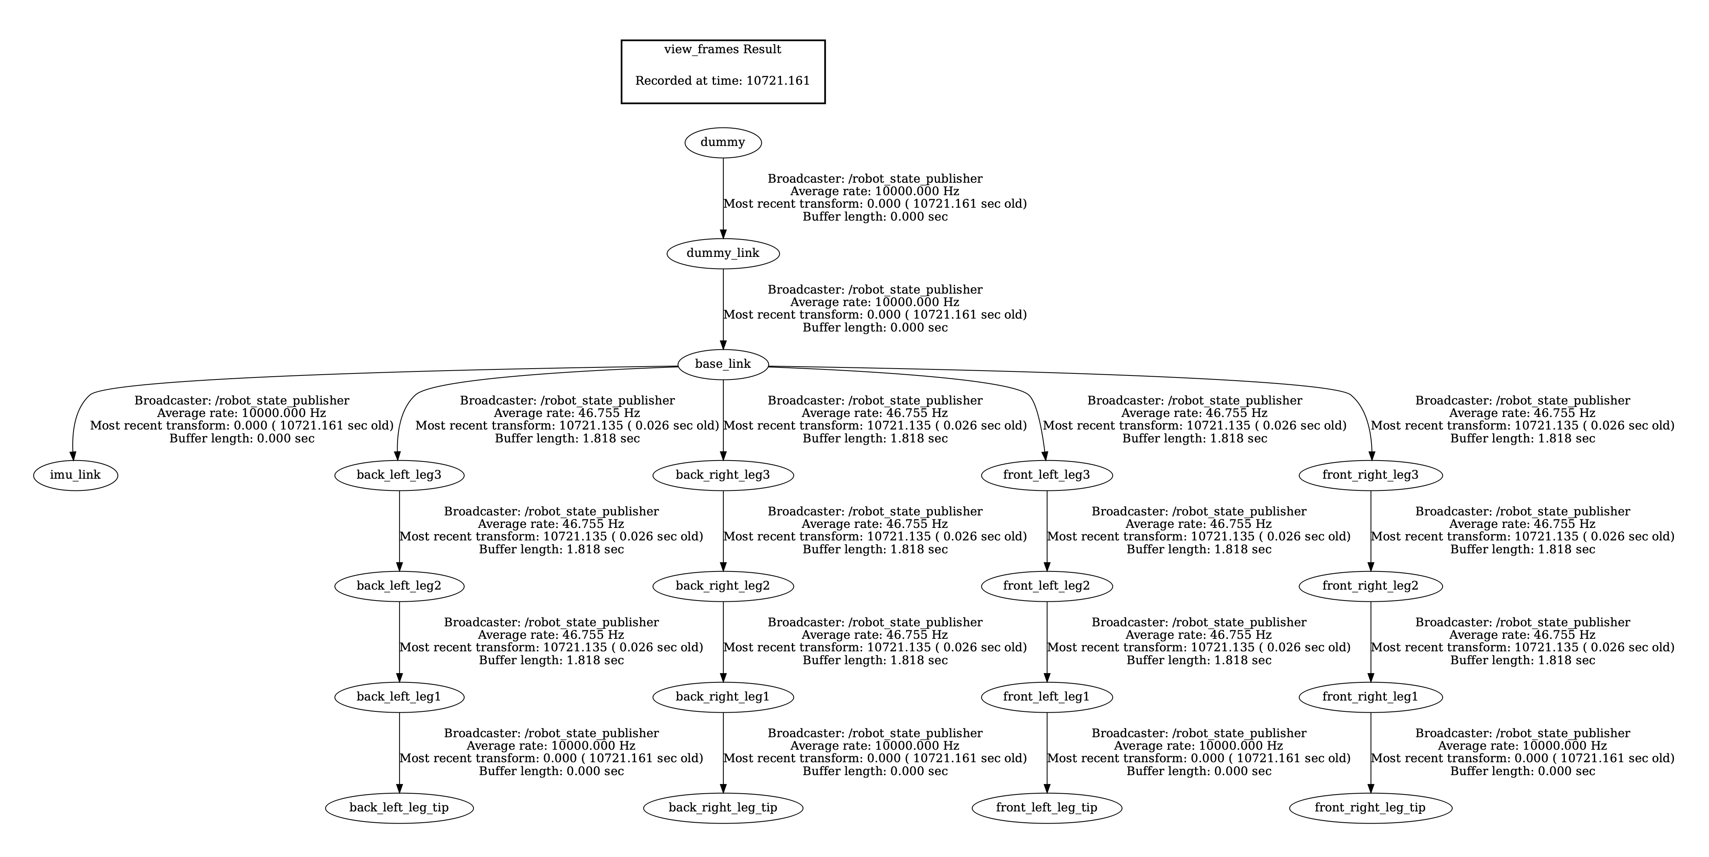
ROS
Quadruped Model

Slide 37
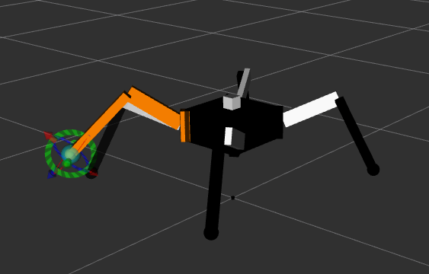
ROS
Quadruped Model - MoveIt!
A
“MoveIt!” is a ROS path planning package used to plan manipulator paths
“MoveIt!” was used to track the position of as end-effector, that is the leg tip as the leg moved from point A to point B
This package was used in the computation of the stability reward and replaced the previous derived kinematics model of the quadruped
B

Slide 38
ROS
Sensors
The following sensors are mounted on the quadruped simulation model:
IMU sensor:
To obtain orientation, linear acceleration and angular velocity
Sensed information used to construct robot state
Mounted at the top of the base link
Contact Sensors
To obtain Point of contact, normal forces and other contact related information
Used to compute stability criteria of the reward

Slide 39
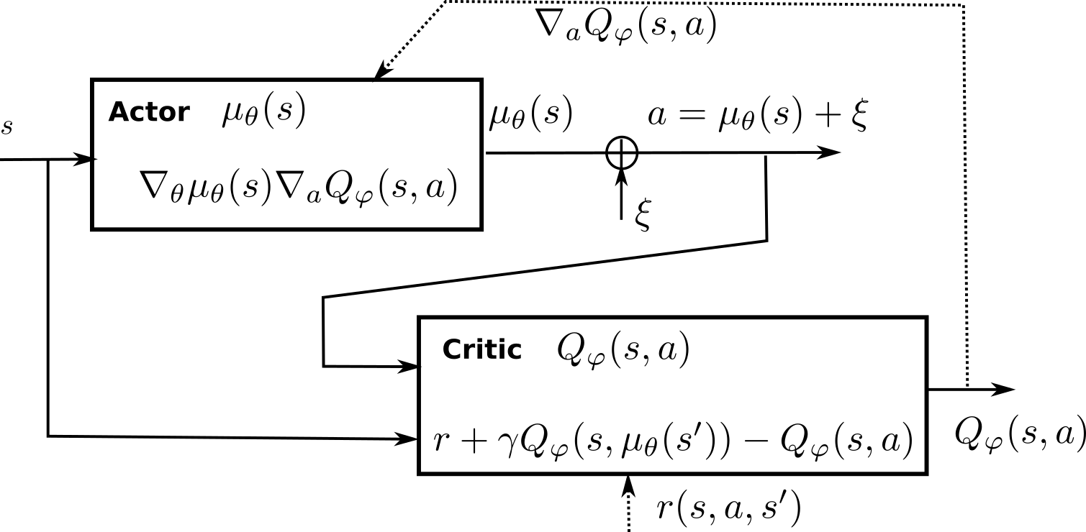
Reinforcement Learning
Deep Deterministic Policy Gradient

Slide 40
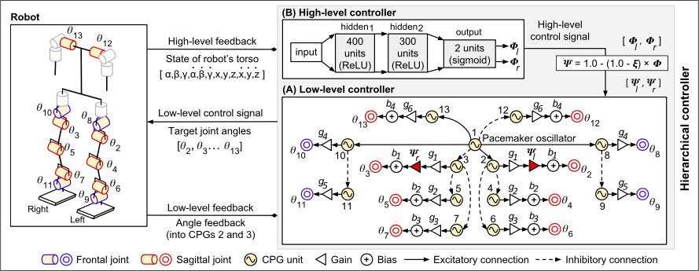
Reinforcement Learning
DDPG : Inspiration

Slide 41
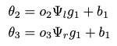
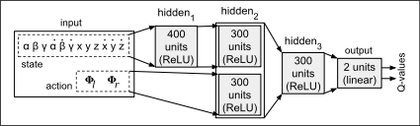
Reinforcement Learning
DDPG : Inspiration
The proposed DDPG model is inspired by the DDPG for the higher level controller for the biped, proposed in [6]
The CPG model in [6] is tuned using GA instead of inclusion in the DDPG
The Actor Network in [6] produces the $ψ_{l}$ and $ψ_{r}$ which are used to steer the biped by modifying the gait signal according to the following equations:
The proposed DDPG model combines CPG and MLP training to tune gait generation in a single step
Critic Network in [6]

Slide 42
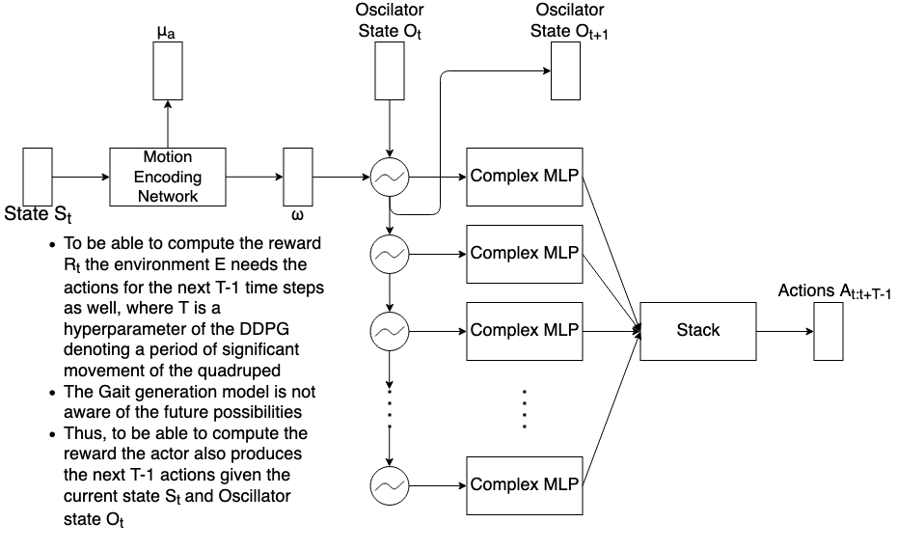
Reinforcement Learning
Actor Network
$A_{t}$ will be the joint activations produced by the network at timestep t
$A_{t+1:t+T}$ are used only for reward calculation and then discarded
$O_{t+1}$ is produced by the CPG at timestep t
State produced by the CPG after timestep t are discarded
Such implementation of the Actor Network produces a sliding time window over $2T+1$ actions taken by the quadruped around any timestep t
Unrolled Actor Network

Slide 43
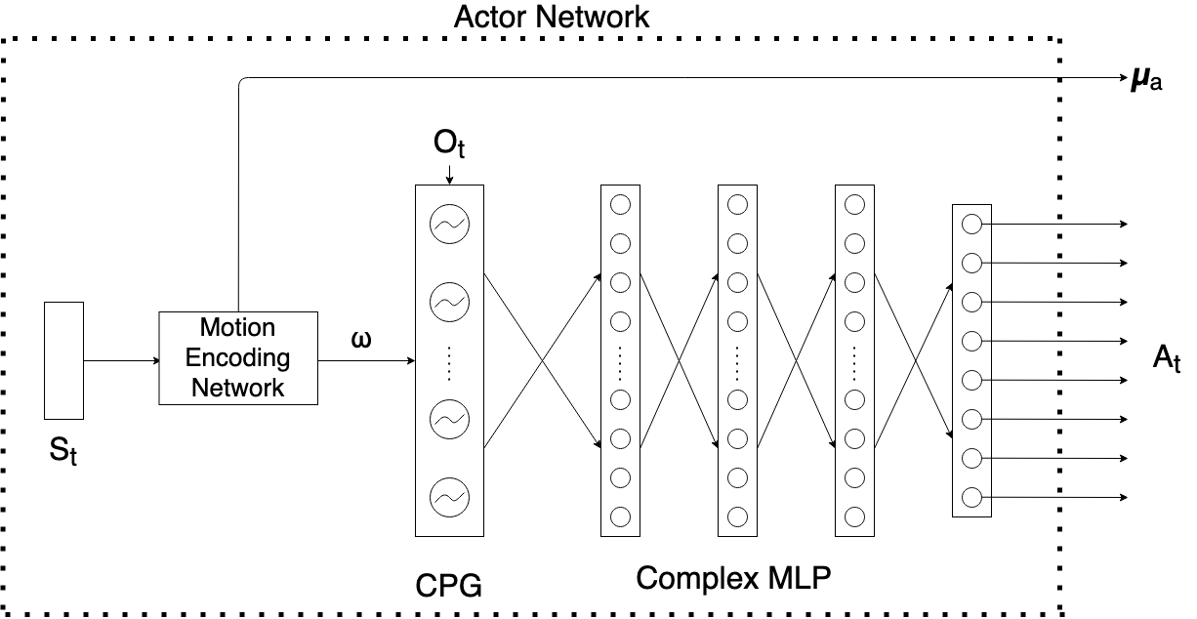
Reinforcement Learning
Snapshot of Actor Network during inference, at timestep t

Slide 44
Reinforcement Learning
Snapshot of Actor Network during inference, at timestep t
The Actor gives two outputs $μ_{a}$ and $A_{t}$
$μ_{a}$ is the normalised gait amplitude. The gait amplitude is limited within a range of $[0,\frac{π}{3}]$. $μ_{a}=1$ implies amplitude of $\frac{π}{3}$
$A_{t}$ is the normalised gait signal
The vector $μ_{a}∘A_{t}$ is fed to the quadruped for gait generation
The Normalisation is performed to improve convergence of the Actor model during pre-training

Slide 45
Reinforcement Learning
Actor Network: Oscillator Layer
Hopf Oscillator was used within the Oscillator layer
The oscillator was chosen because of its limit cycle behaviour at all parameter values
A Oscillator Layer serves as the recurrent layer within the actor and generates the basis signals which are then combined by the complex MLP to produce the gait signal
$$\overset{·}{z}=(μ-∣z∣^{2})z-zω$$
Complex Equation of Hopf Oscillator
$$x_{t+1}=x_{t}+(-yω+x(μ-x^{2}-y^{2}))dt$$
$$y_{t+1}=y_{t}+(xω+y(μ-x^{2}-y^{2}))dt$$
Cartesian Equations of Hopf Oscillator

Slide 46
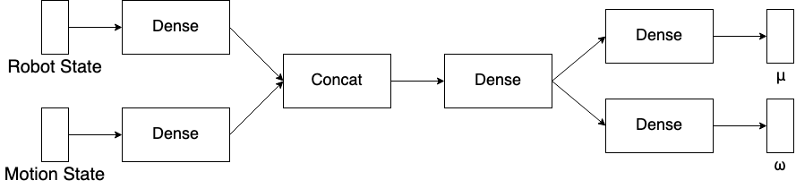
Reinforcement Learning
Actor Network : Motion Encoding Network
$S_{t}$ comprises of the following components:
Robot State:
Current Joint Angles
Difference between current and last joint positions
Orientation
Angular Velocity
Linear Acceleration
Motion State :
Desired Turning
Desired Speed along x and y axes

Slide 47
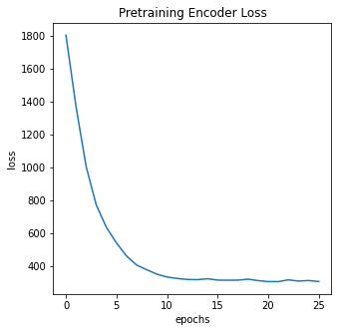
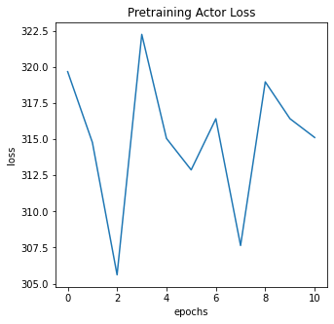
Reinforcement Learning
Actor Network : Architecture Limitations
Proposed Actor Architecture has the following limitations:
The Network has no provisions for realising gait transition
The Network has no provisions for realising turning behaviour
The omega for the oscillator layer is sensitive to robot initial state, which should not be the case
Pre-training of the network fails to converges at a local minima instead of a global minima

Slide 48
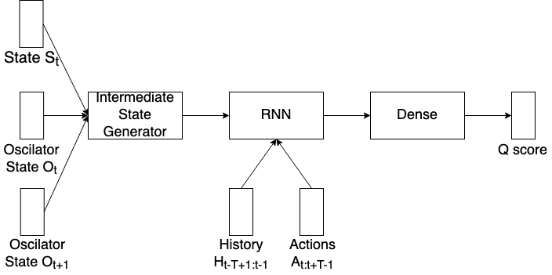
Reinforcement Learning
Critic Network
Critic is an RNN that iterates over the $H_{t-T+1:t-1}$ and $A_{t:t+T-1}$
The initial state of the RNN is generated by the intermediate state generator
The last output of the RNN is input to a dense layer to output the predicted Q scores
The Intermediate State Generator combines $O_{t}$, $O_{t+1}$ and $S_{t}$ into a single state vector
The RNN cell to be used is LSTM

Slide 49
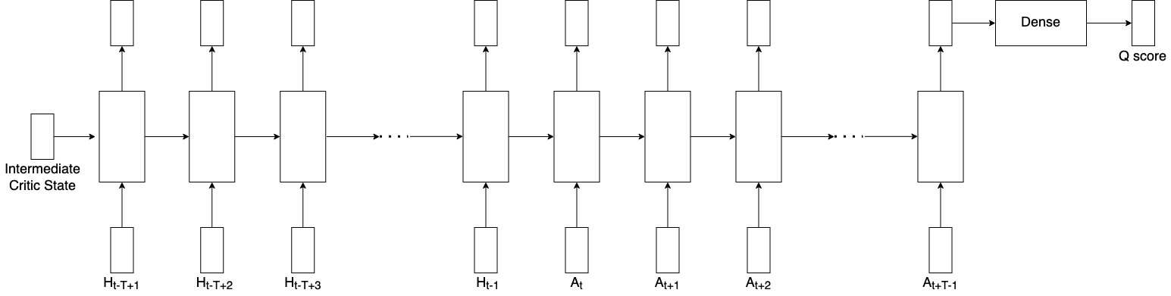
Reinforcement Learning
Critic Network : RNN
The Q Score predicted by the RNN takes into account the actions over the time window of $2T-1$ actions around a timestep $t$ given $S_{t}$, $O_{t}$ and $O_{t+1}$

Slide 50
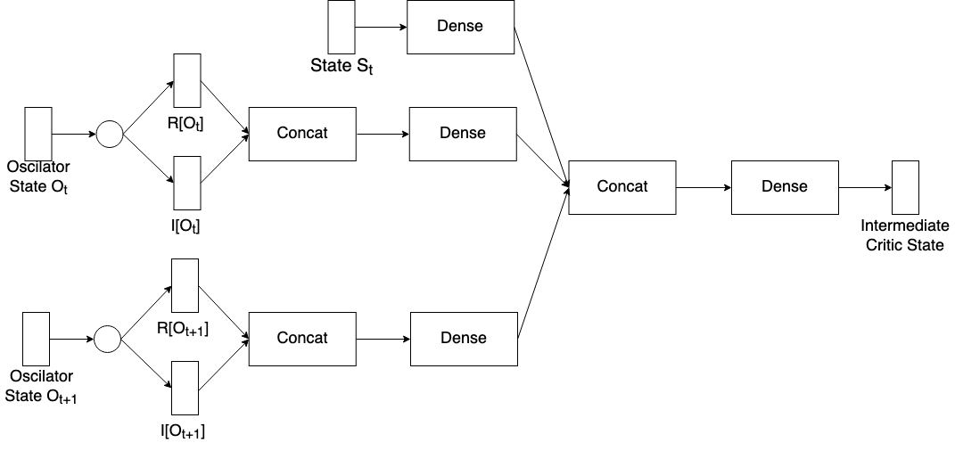
Reinforcement Learning
Critic Network : Intermediate State Generator
$O_{t}$ and $O_{t+1}$ are complex numbers
Real and Imaginary parts of $O_{t}$ and $O_{t+1}$ are concatenated and passed to a dense layer
Intermediate Critic State is a combination of $S_{t}$, $O_{t}$ and $O_{t+1}$ and is a vector of the same size as an RNN layer

Slide 51
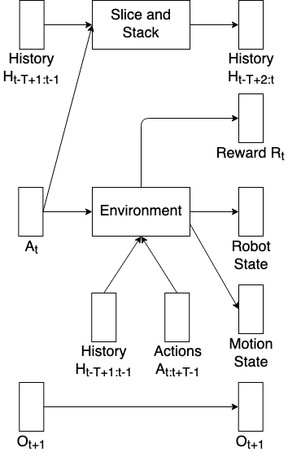
Reinforcement Learning
Environment
History consists of the action from the previous $T-1$ timesteps
History is initialised with $T-1$ repetitions of the initial joint positions
The Environment produces the Robot State and Motion State given $A_{t}$
Reward $R_{t}$ is produced by the environment given History $H_{t-T+1:t-1}$ and Actions $A_{t:t+T-1}$
The Oscillator State produced is passed on unchanged
$H_{t-T+1:t-1}$ is sliced and stacked with $A_{t}$ to get $H_{t-T+2:t}$ which is the history for the timestep $t+1$

Slide 52
Training Procedure
Multi Stepped Training Procedure
Training of the gait generation network in two steps:
Pre-training of the Actor Network
Reinforcement Learning of DDPG
Two stepped process to ensure quicker and smoother convergence to an optima during Reinforcement Learning
The Pre-training steps provides information to the model about the process of gait, whereas Reinforcement Learning allows for fine-tuning of the knowledge from pre-training based on real world experience

Slide 53
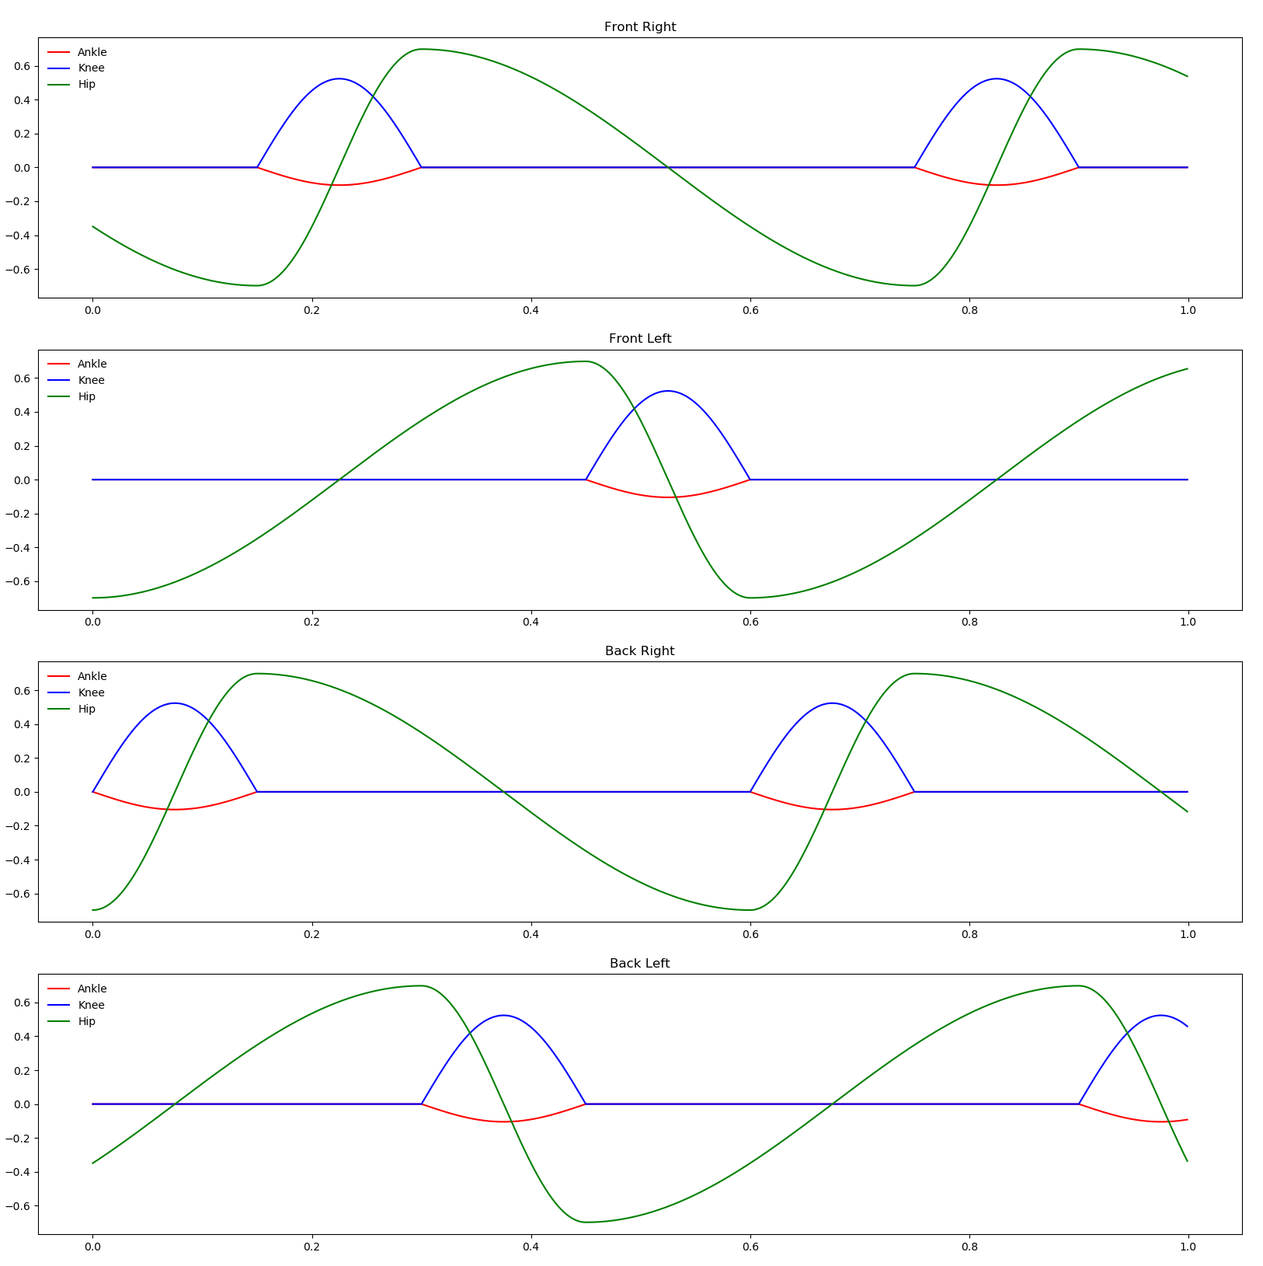
Training Procedure
Multi Stepped Training
The gait pattern used for pre-training is normalised
Pre-training only using creep gait pattern
Gait Transition and other gaits are expected to be learnt through Reinforcement Learning

Slide 54
Pre-training
Back-propagation Schemes
Due to the optimisation of the neural network being a multi objective optimisation problem
This leads to conflicts in updates causing the optimisation to not converge
To alleviate this conflicting effect the following schemes of optimisations to be experimented with:
Entire Actor through signal MSE and Motion Encoder through $ω$ and $μ$ MSE both in the same step
Complex MLP through signal MSE and Motion Encoder through $ω$ and $μ$ MSE both in the same step
Motion Encoder through $ω$ and $μ$ MSE in step 1 followed by entire Actor through signal MSE and Motion Encoder through $ω$ and $μ$ MSE in step 2
Motion Encoder through $ω$ and $μ$ MSE in step 1 followed by entire Actor through signal MSE in step 2

Slide 55
References
Masuri, Ariel; Medina, Oded; Hacohen, Shlomi; Shvalb, Nir (2020) ‘Gait and Trajectory Optimization by Self-Learning for Quadrupedal Robots with an Active Back Joint’
Jia, Yan; Lua, Xiao; Han, Baoling; Liang, Guanhao; Zhao, Jiaheng; Zhao, Yuting (2018) ‘Stability Criterion for Dynamic Gaits of Quadruped Robot’
Kramer, Oliver; Gong, Daoxiong; Yan, Jie; Zuo, Guoyu (2010) ‘A Review of Gait Optimization Based on Evolutionary Computation’
Timothy P. Lillicrap∗, Jonathan J. Hunt∗, Alexander Pritzel, Nicolas Heess, Tom Erez, Yuval Tassa, David Silver & Daan Wierstra (2016) ‘Continuous Control with Deep Reinforcement Learning’
Bose, Sourabh & Huber, Manfred. (2017). ‘Training Neural Networks with Policy Gradient’
S. Auddy, S. Magg & S. Wermter (2019) "Hierarchical Control for Bipedal Locomotion using Central Pattern Generators and Neural Networks”
Doo Re Song, Chuanyu Yang, Christopher McGreavy, Zhibin Li (2018) “Recurrent Deep Deteministic Policy Gradient Method for Bipedal Locomotion on Rough Terrain Challenge”
Deep Reinforcement Learning

Slide 56
References
Shouwen Fan, Min Sun (2007) “Gait Parameters Optimization and Real-Time Trajectory Planning for Humanoid Robots”

